Slide 1
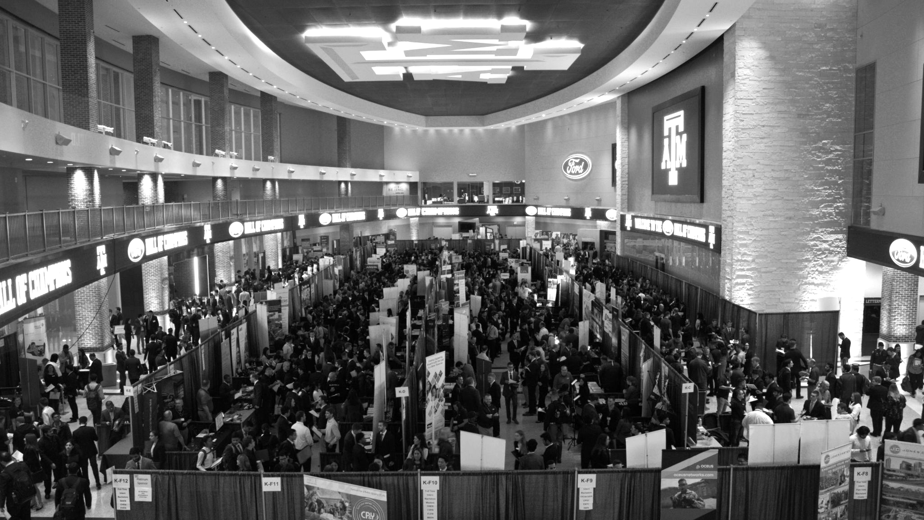

LANL Team Update
02/21/2025
Izzy Baumler, Dalton Boeckmann, Morgan Gullo, Jade Waldron

Slide 2
Problem Statement/Project Motivation
There is a need for a technology that has 5 DOF and can move through its full range of motion in each degree of freedom of at least 1 Hz.

Slide 3
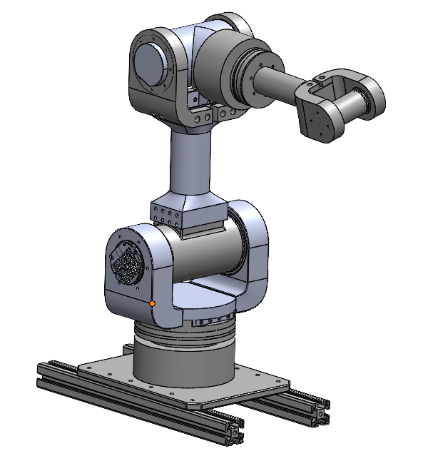
Weekly Assigned Tasks
Jade - Solidworks Refinement/Prototyping/Assembly
Izzy - Motor Research and testing
Dalton - Assembly/Motor Testing
Morgan - Purchase Orders/Electrical

Slide 4
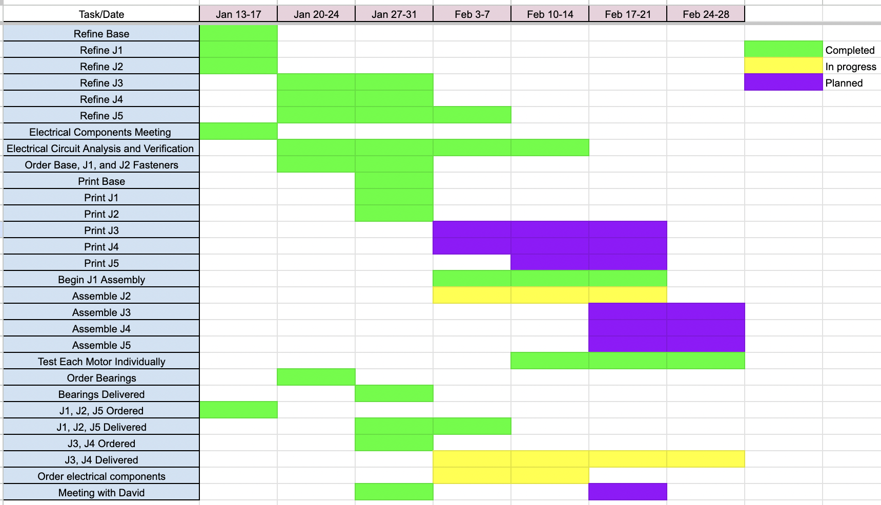
Schedule Update

Slide 5
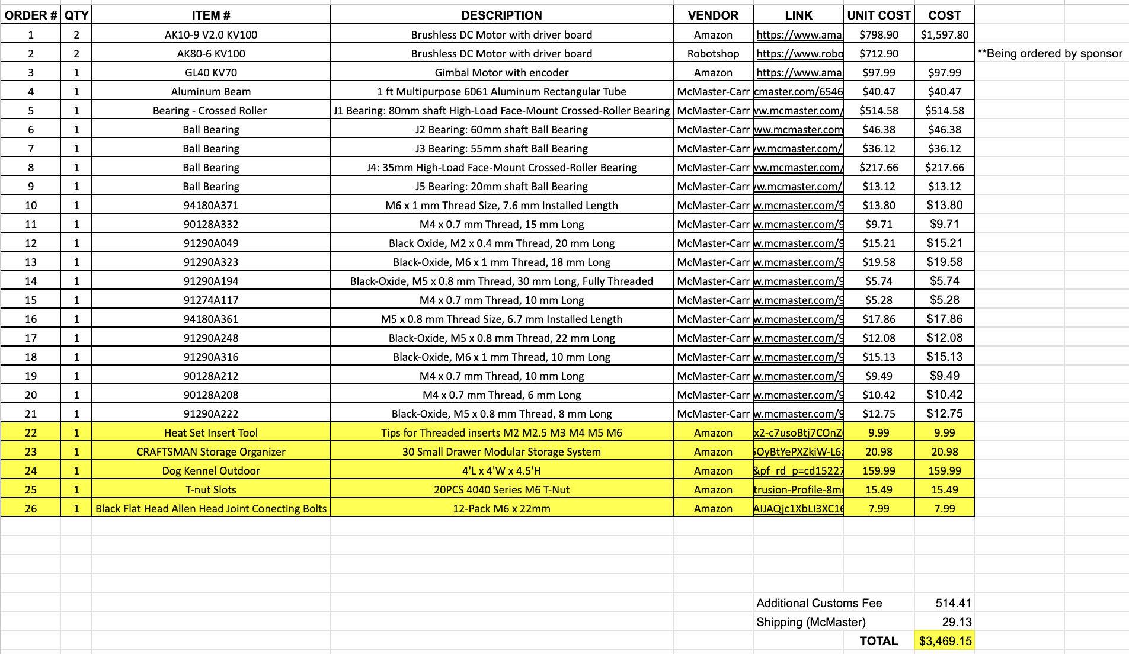
Updated BOM

Slide 6
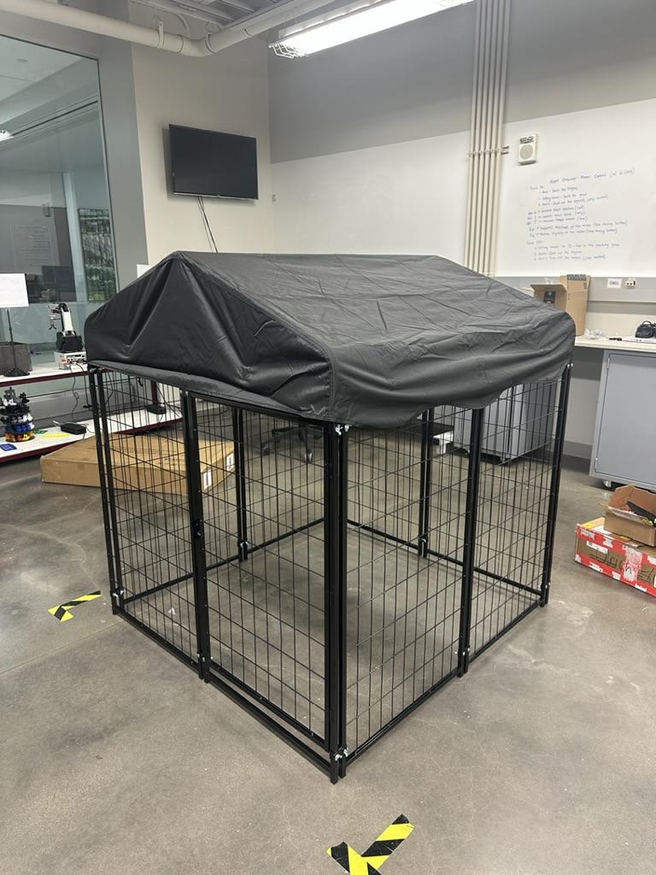
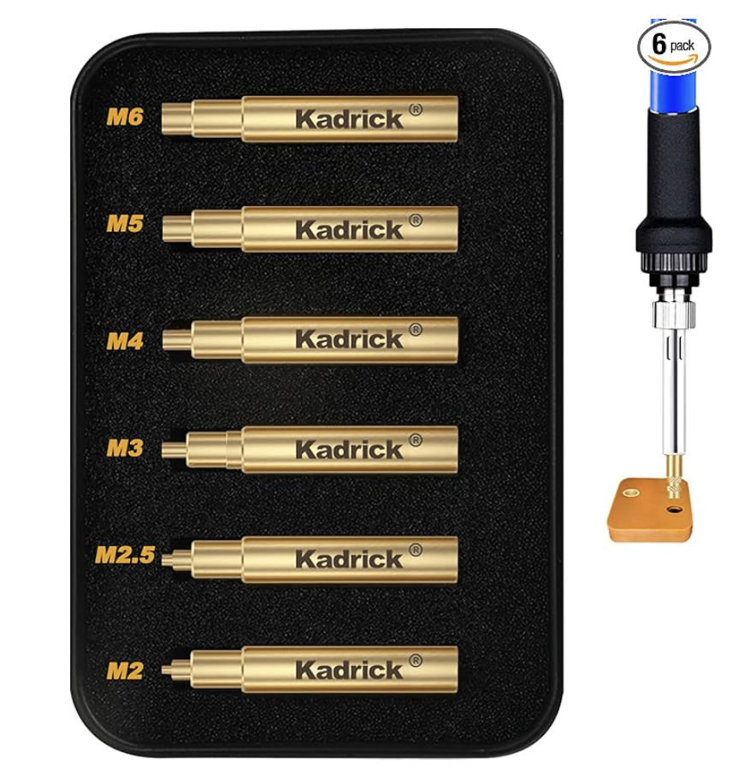
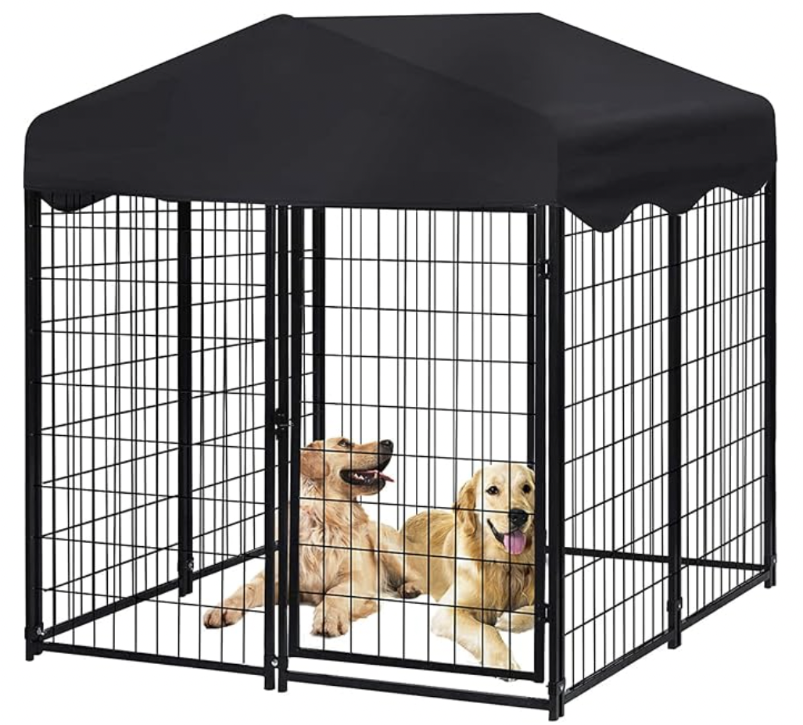
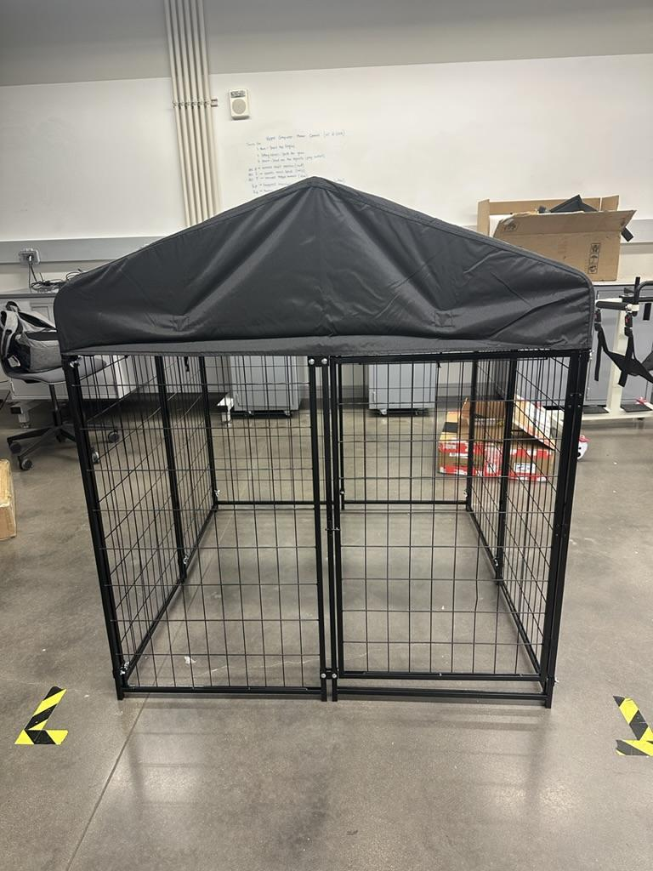
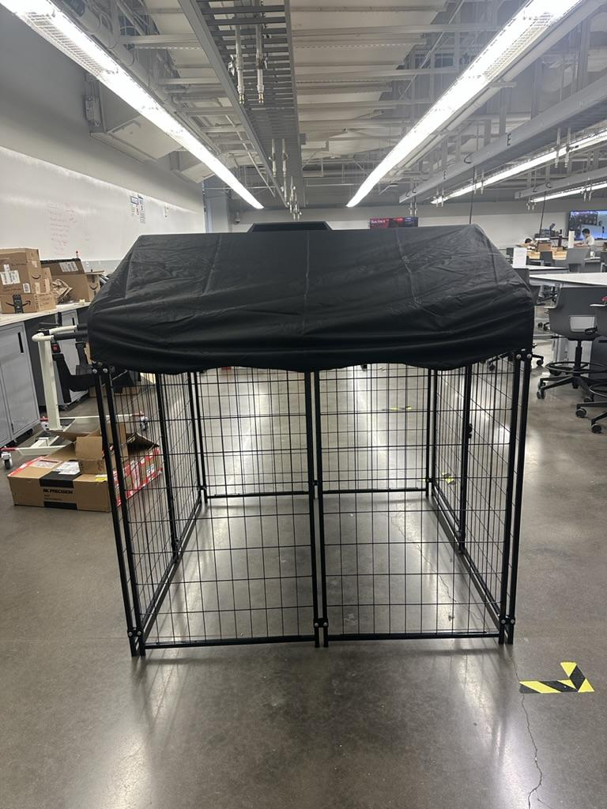
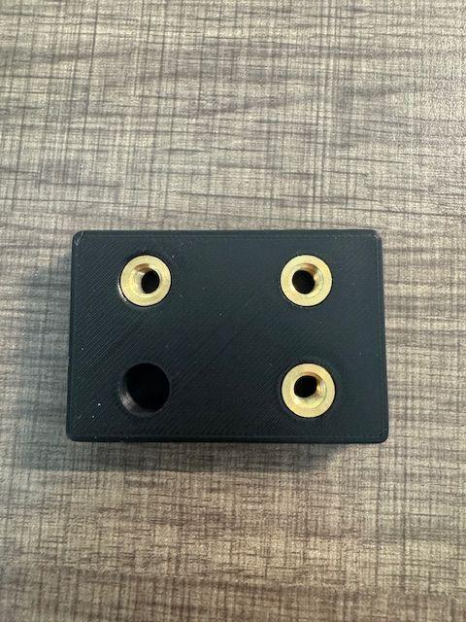
Orders Purchased

Slide 7
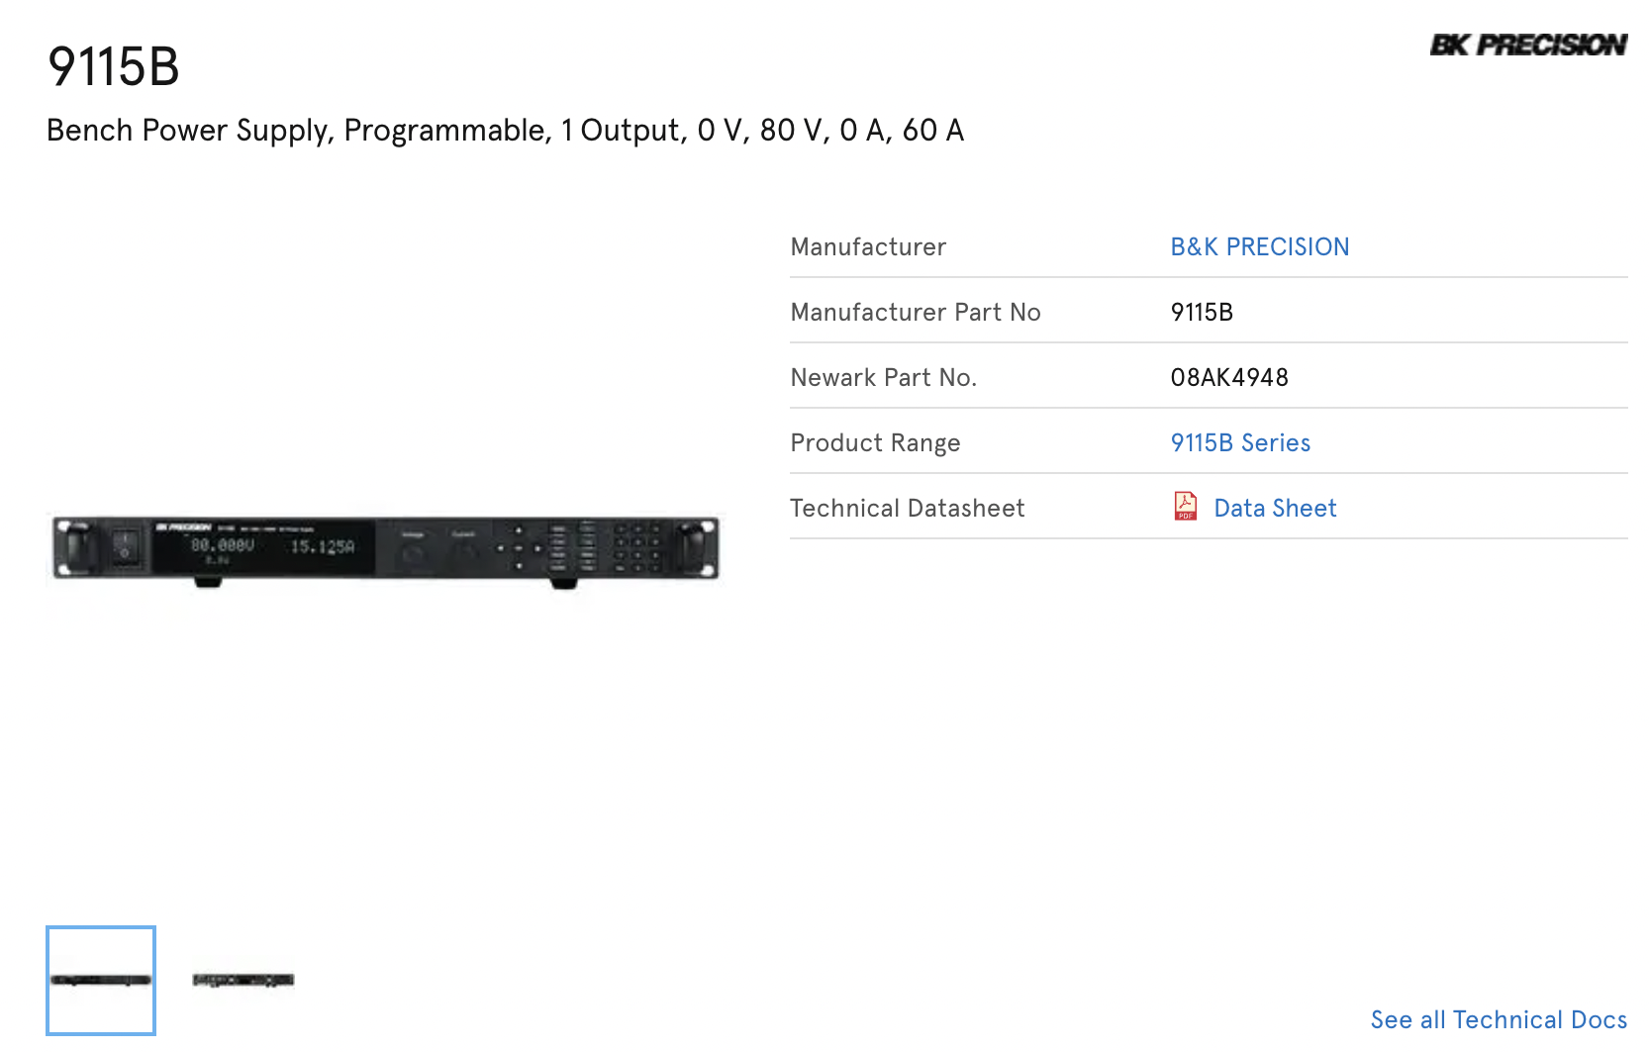
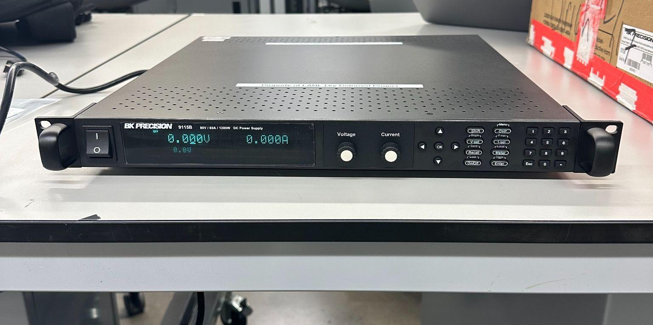
Power Supply

Slide 8
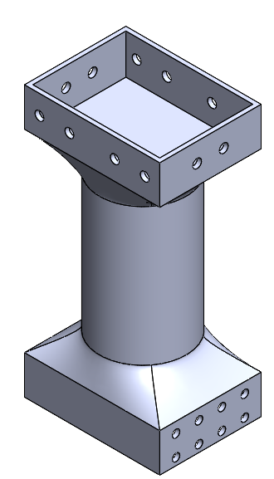
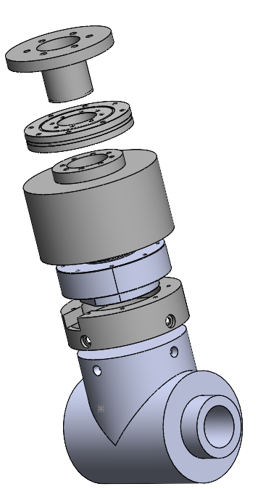
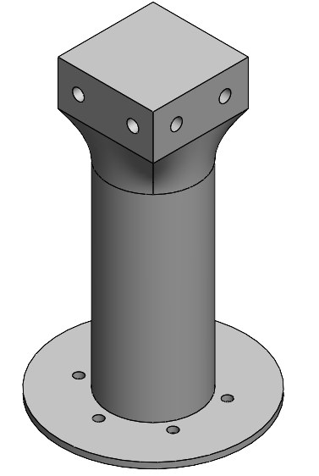
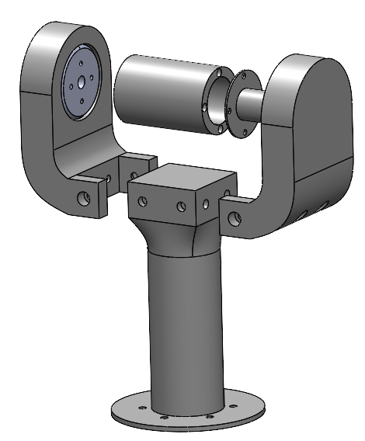
CAD Refinement

Slide 9
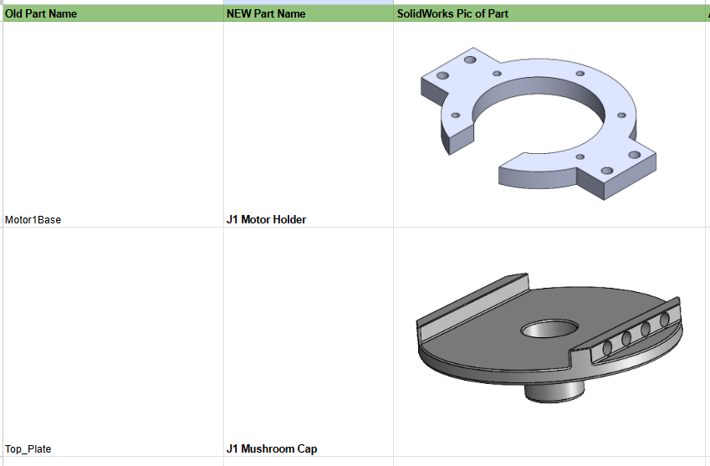
Naming Conventions
Redid Naming Conventions for every SLDPRT
Too much similarity between names

Slide 10
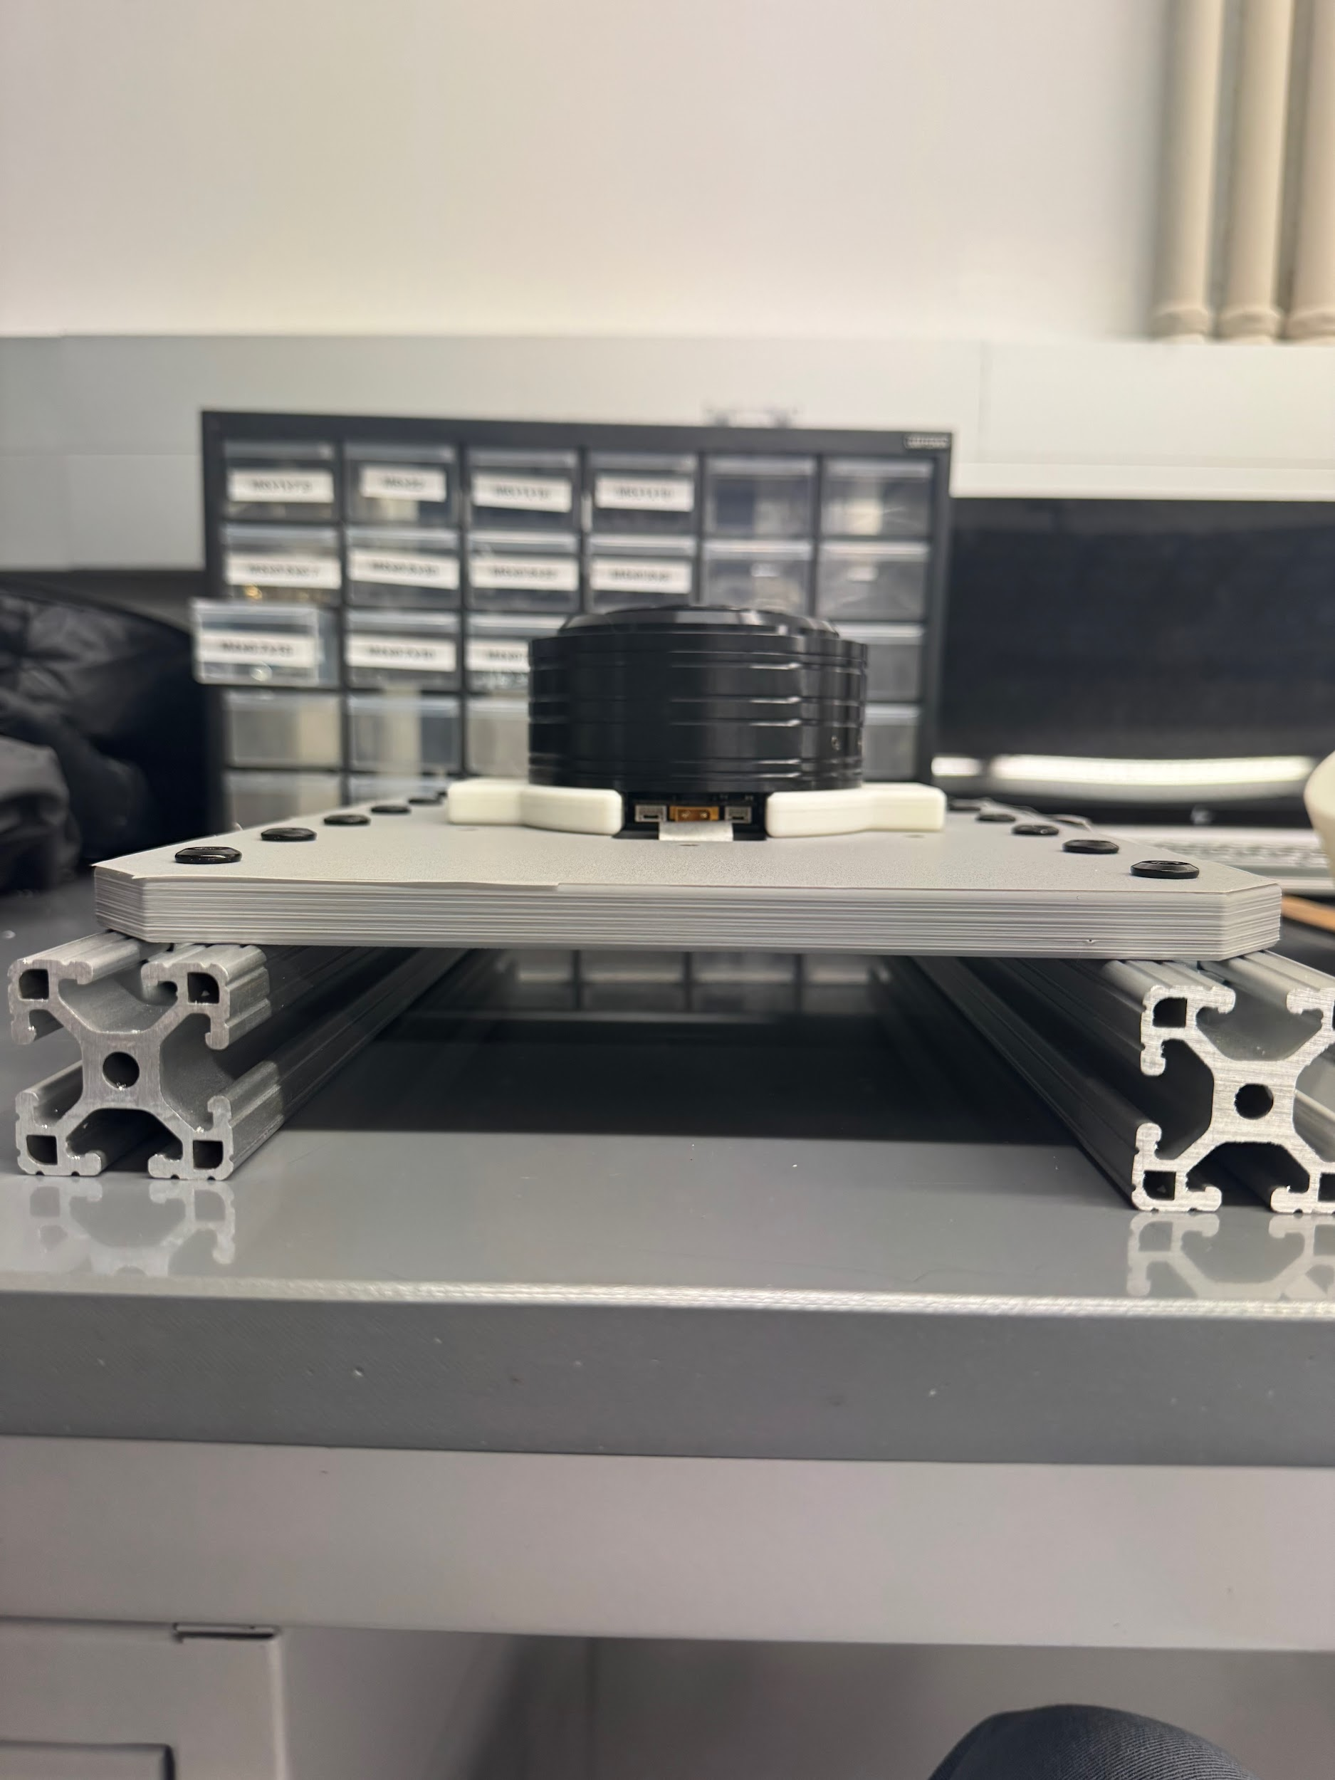
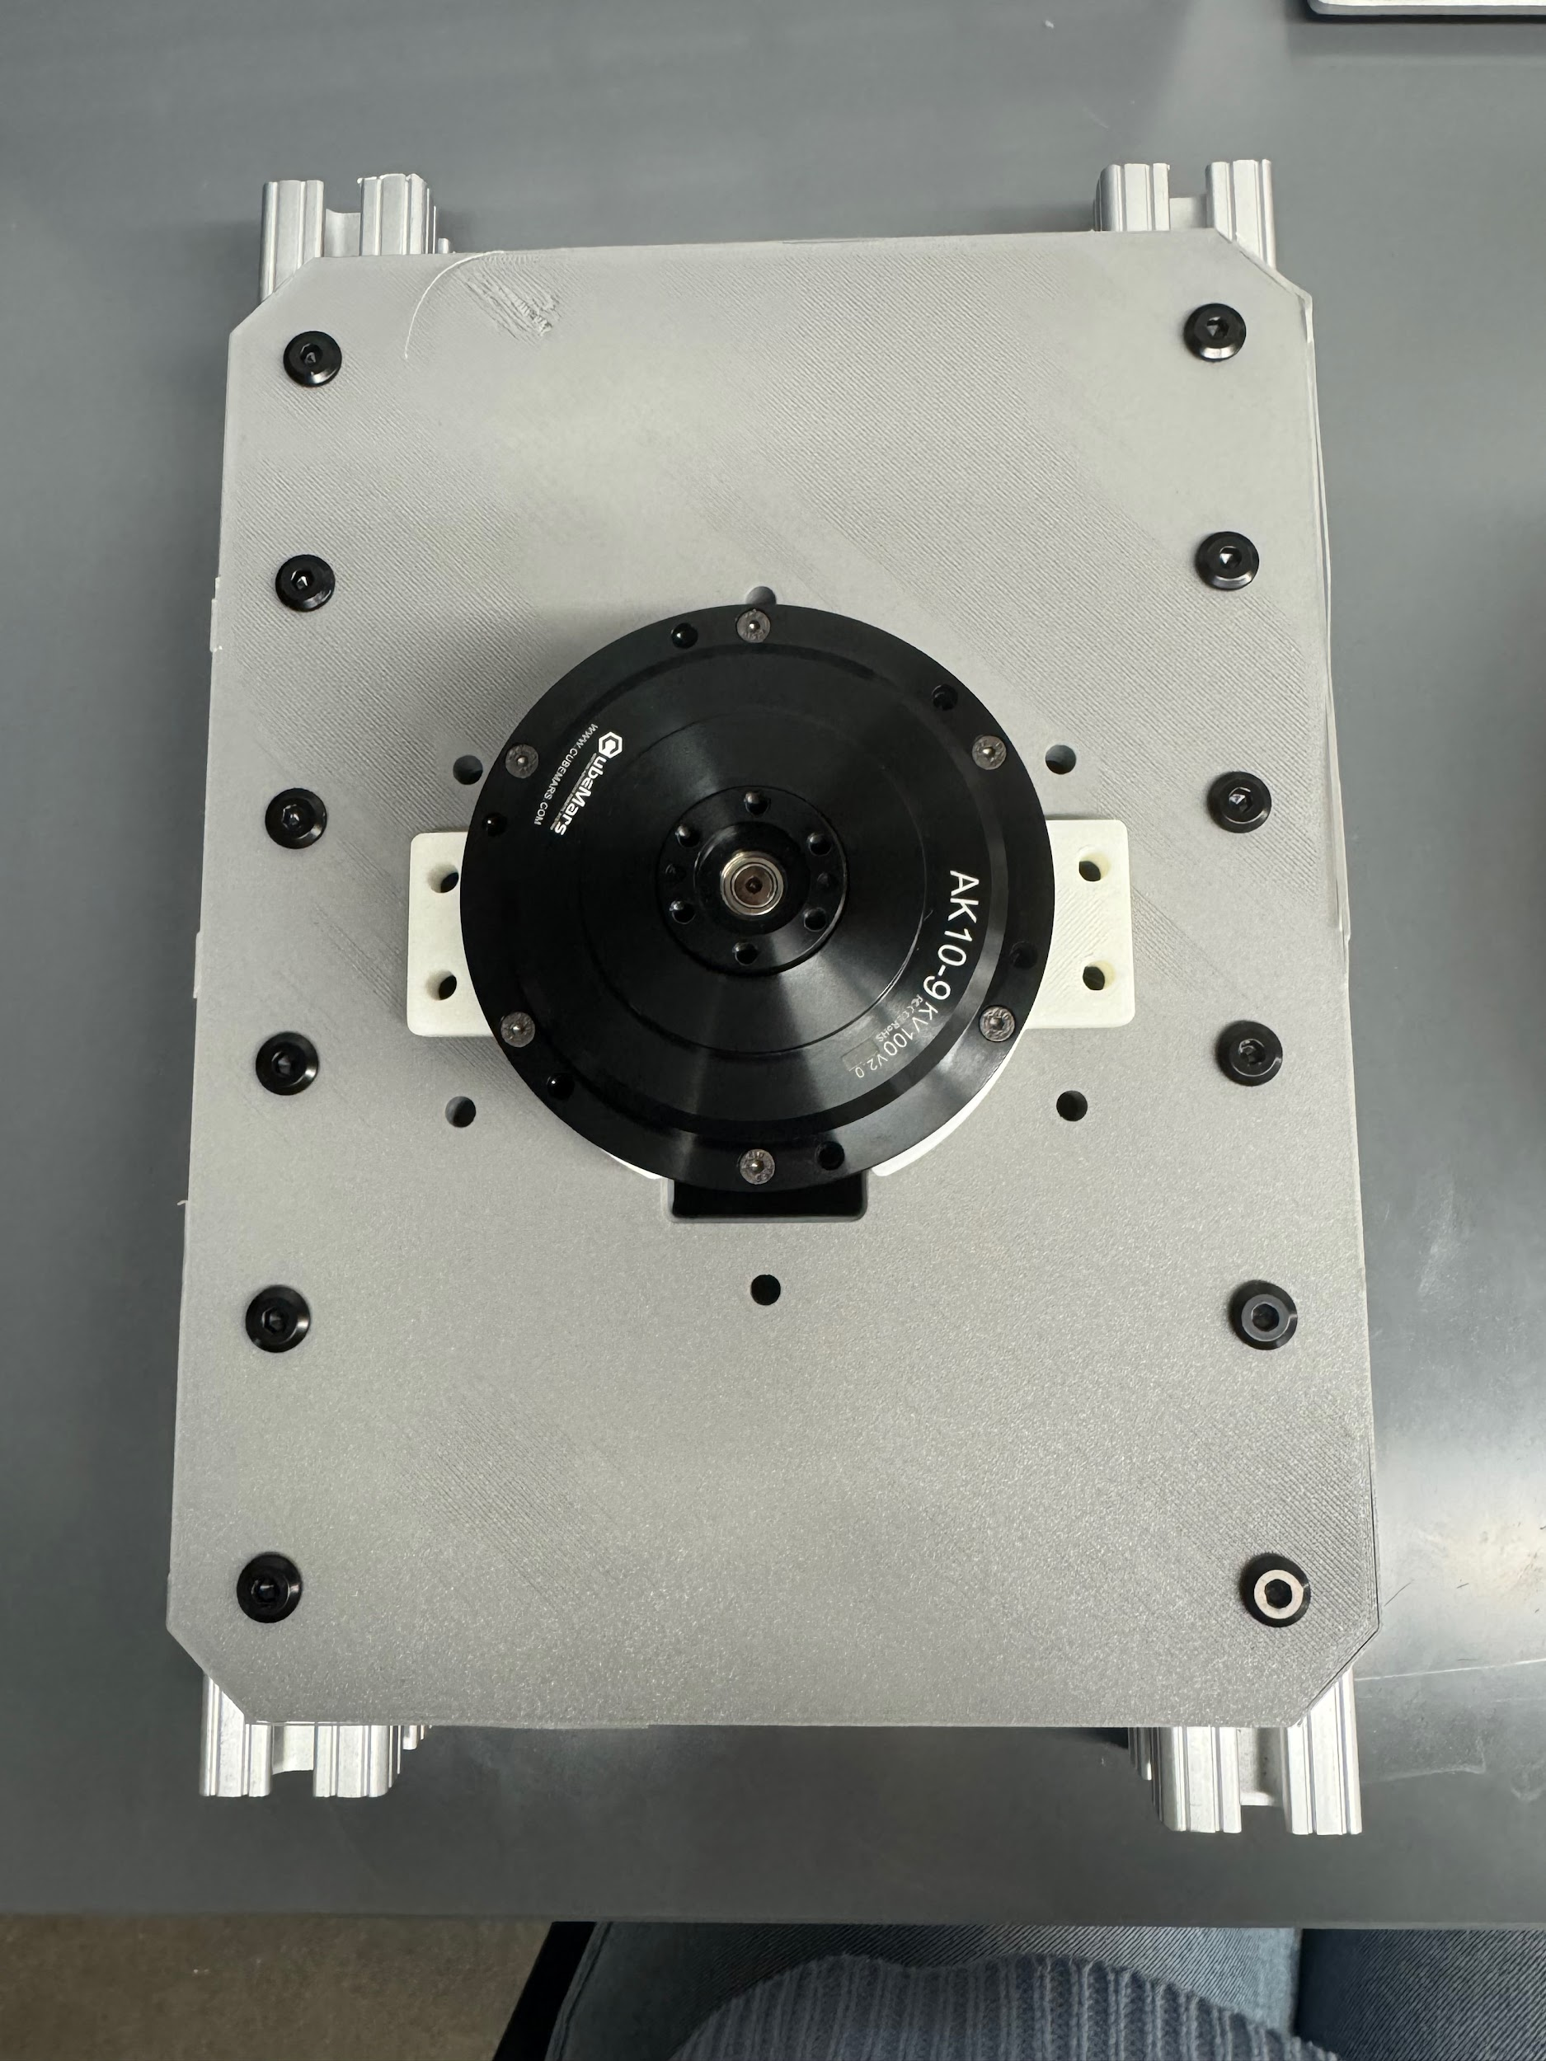
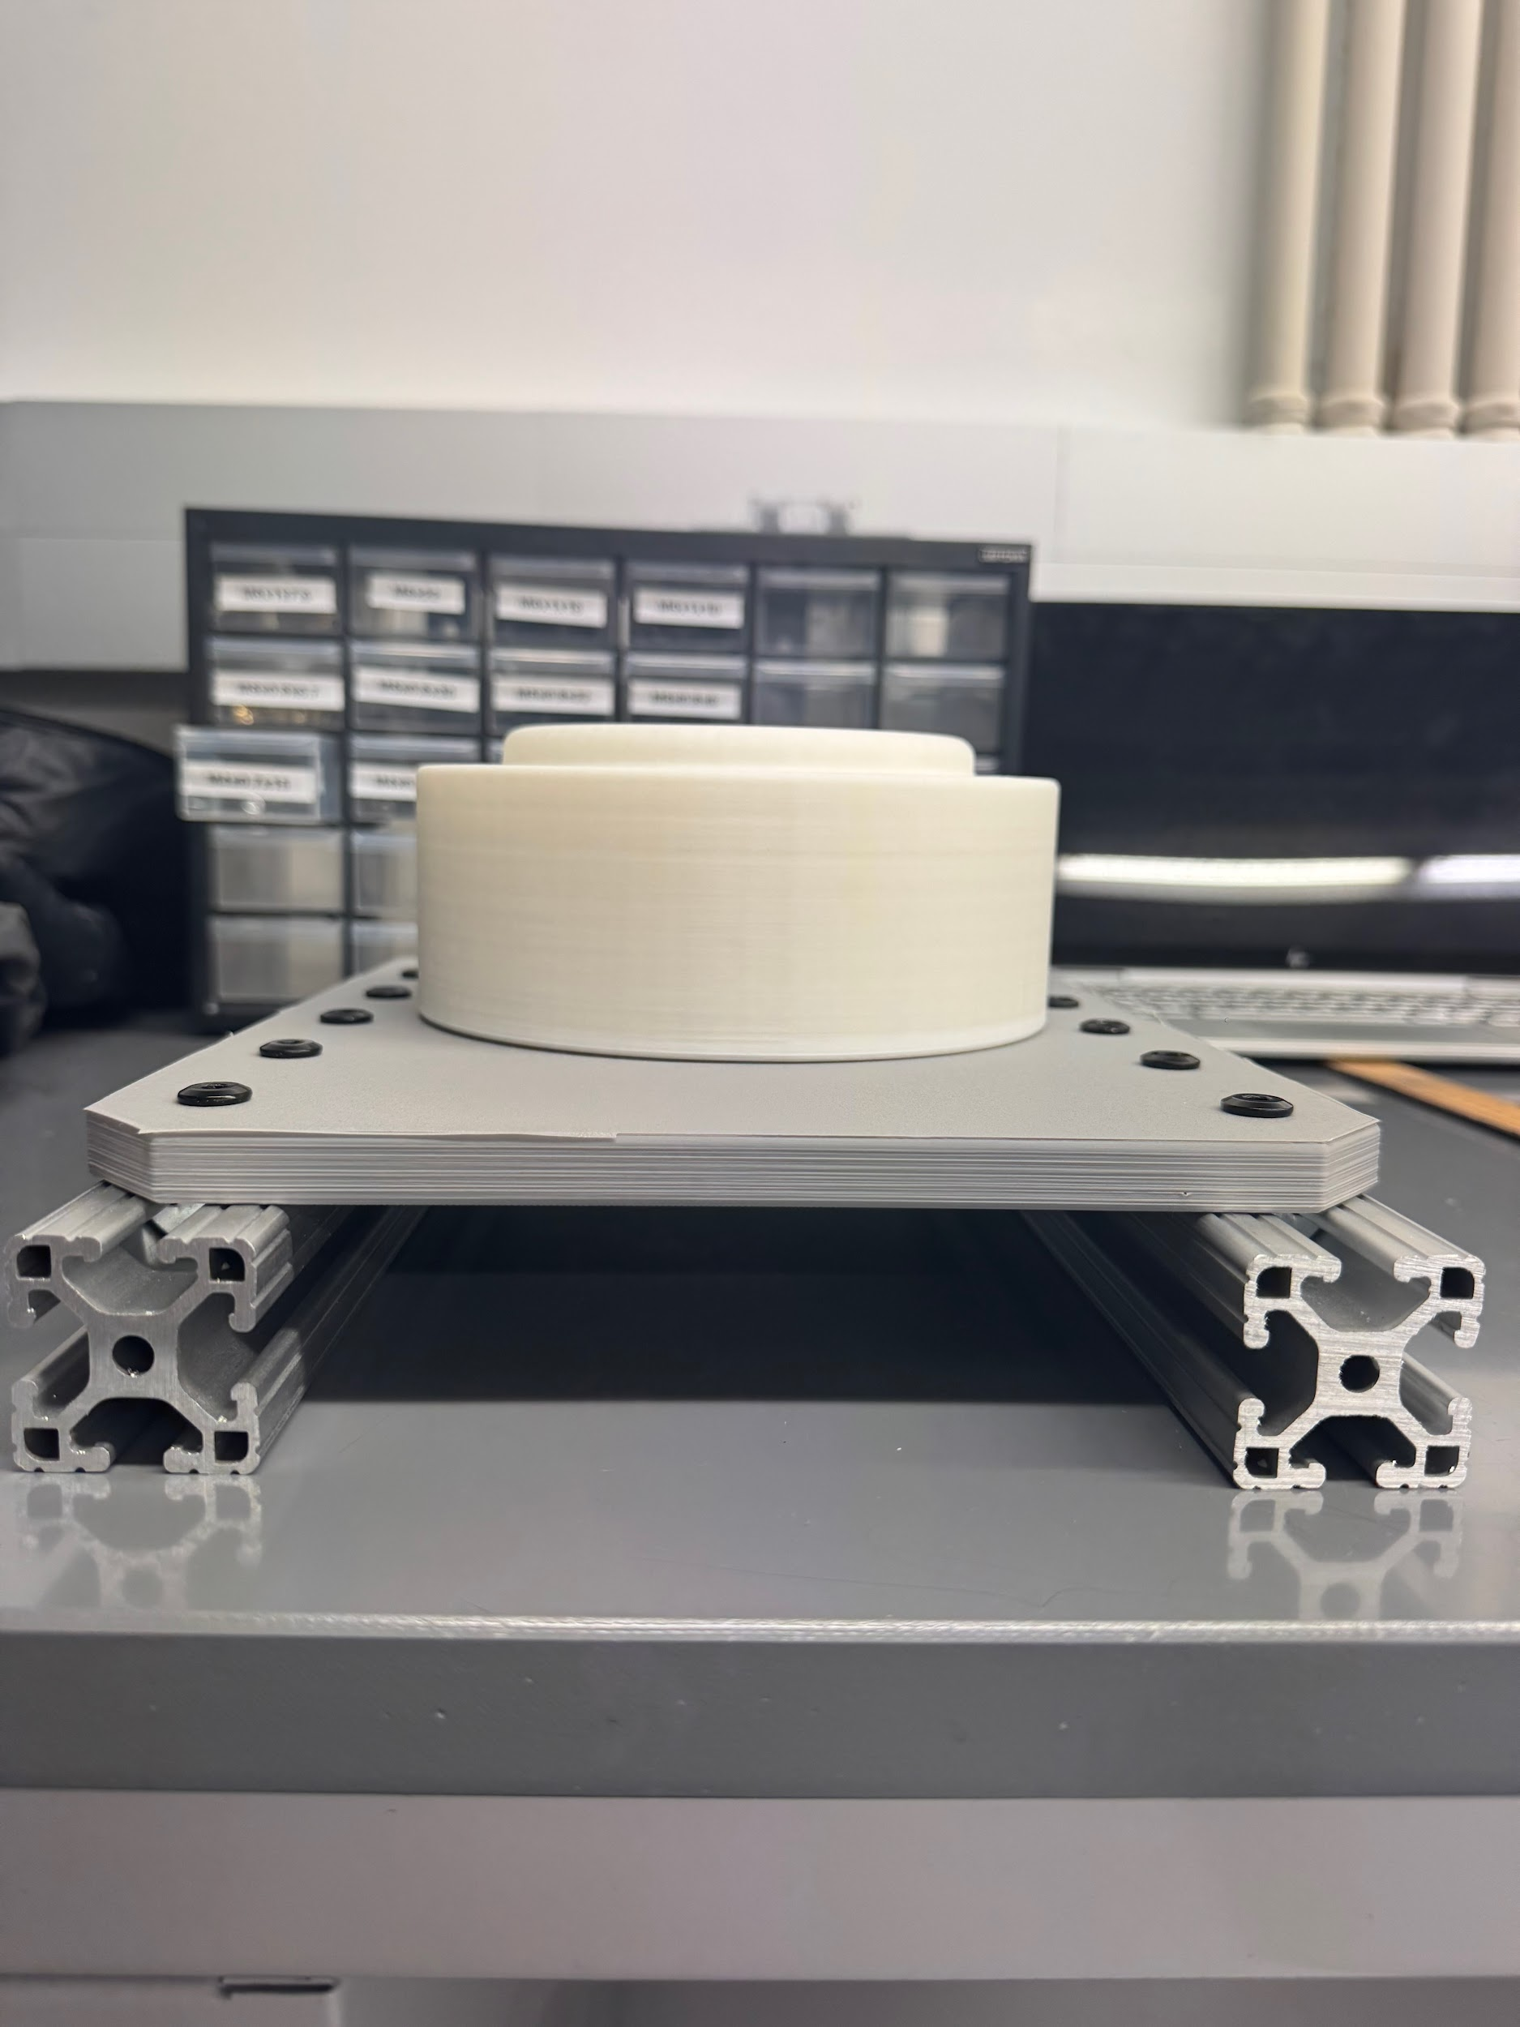
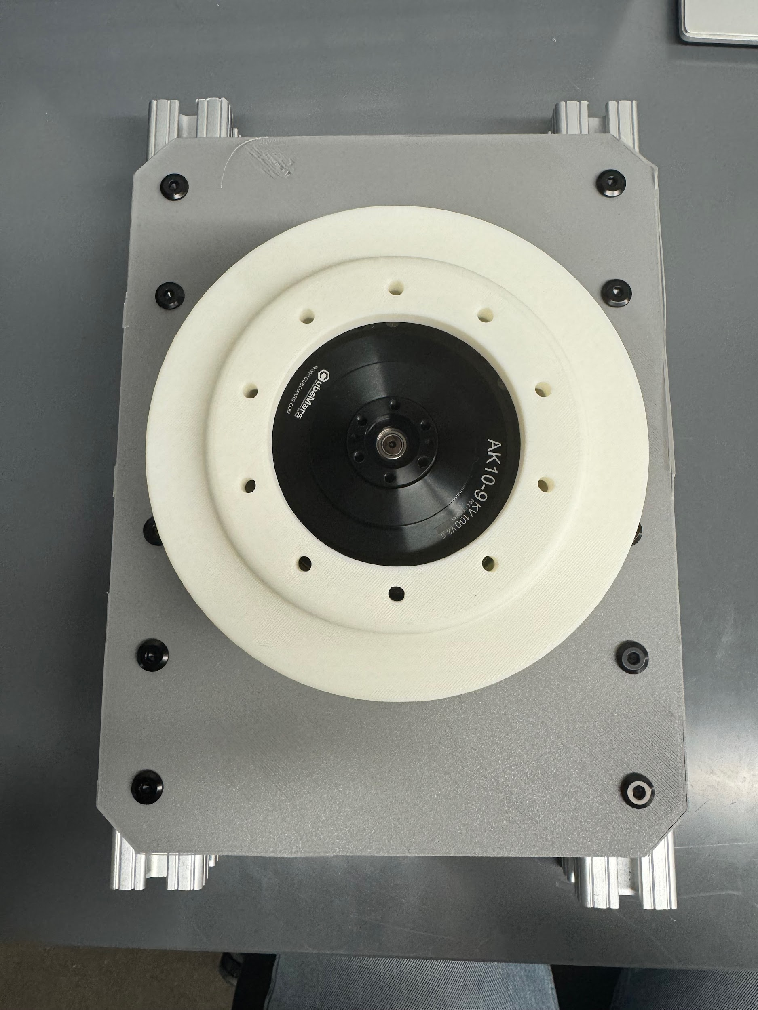
Prototyping/Assembly

Slide 11
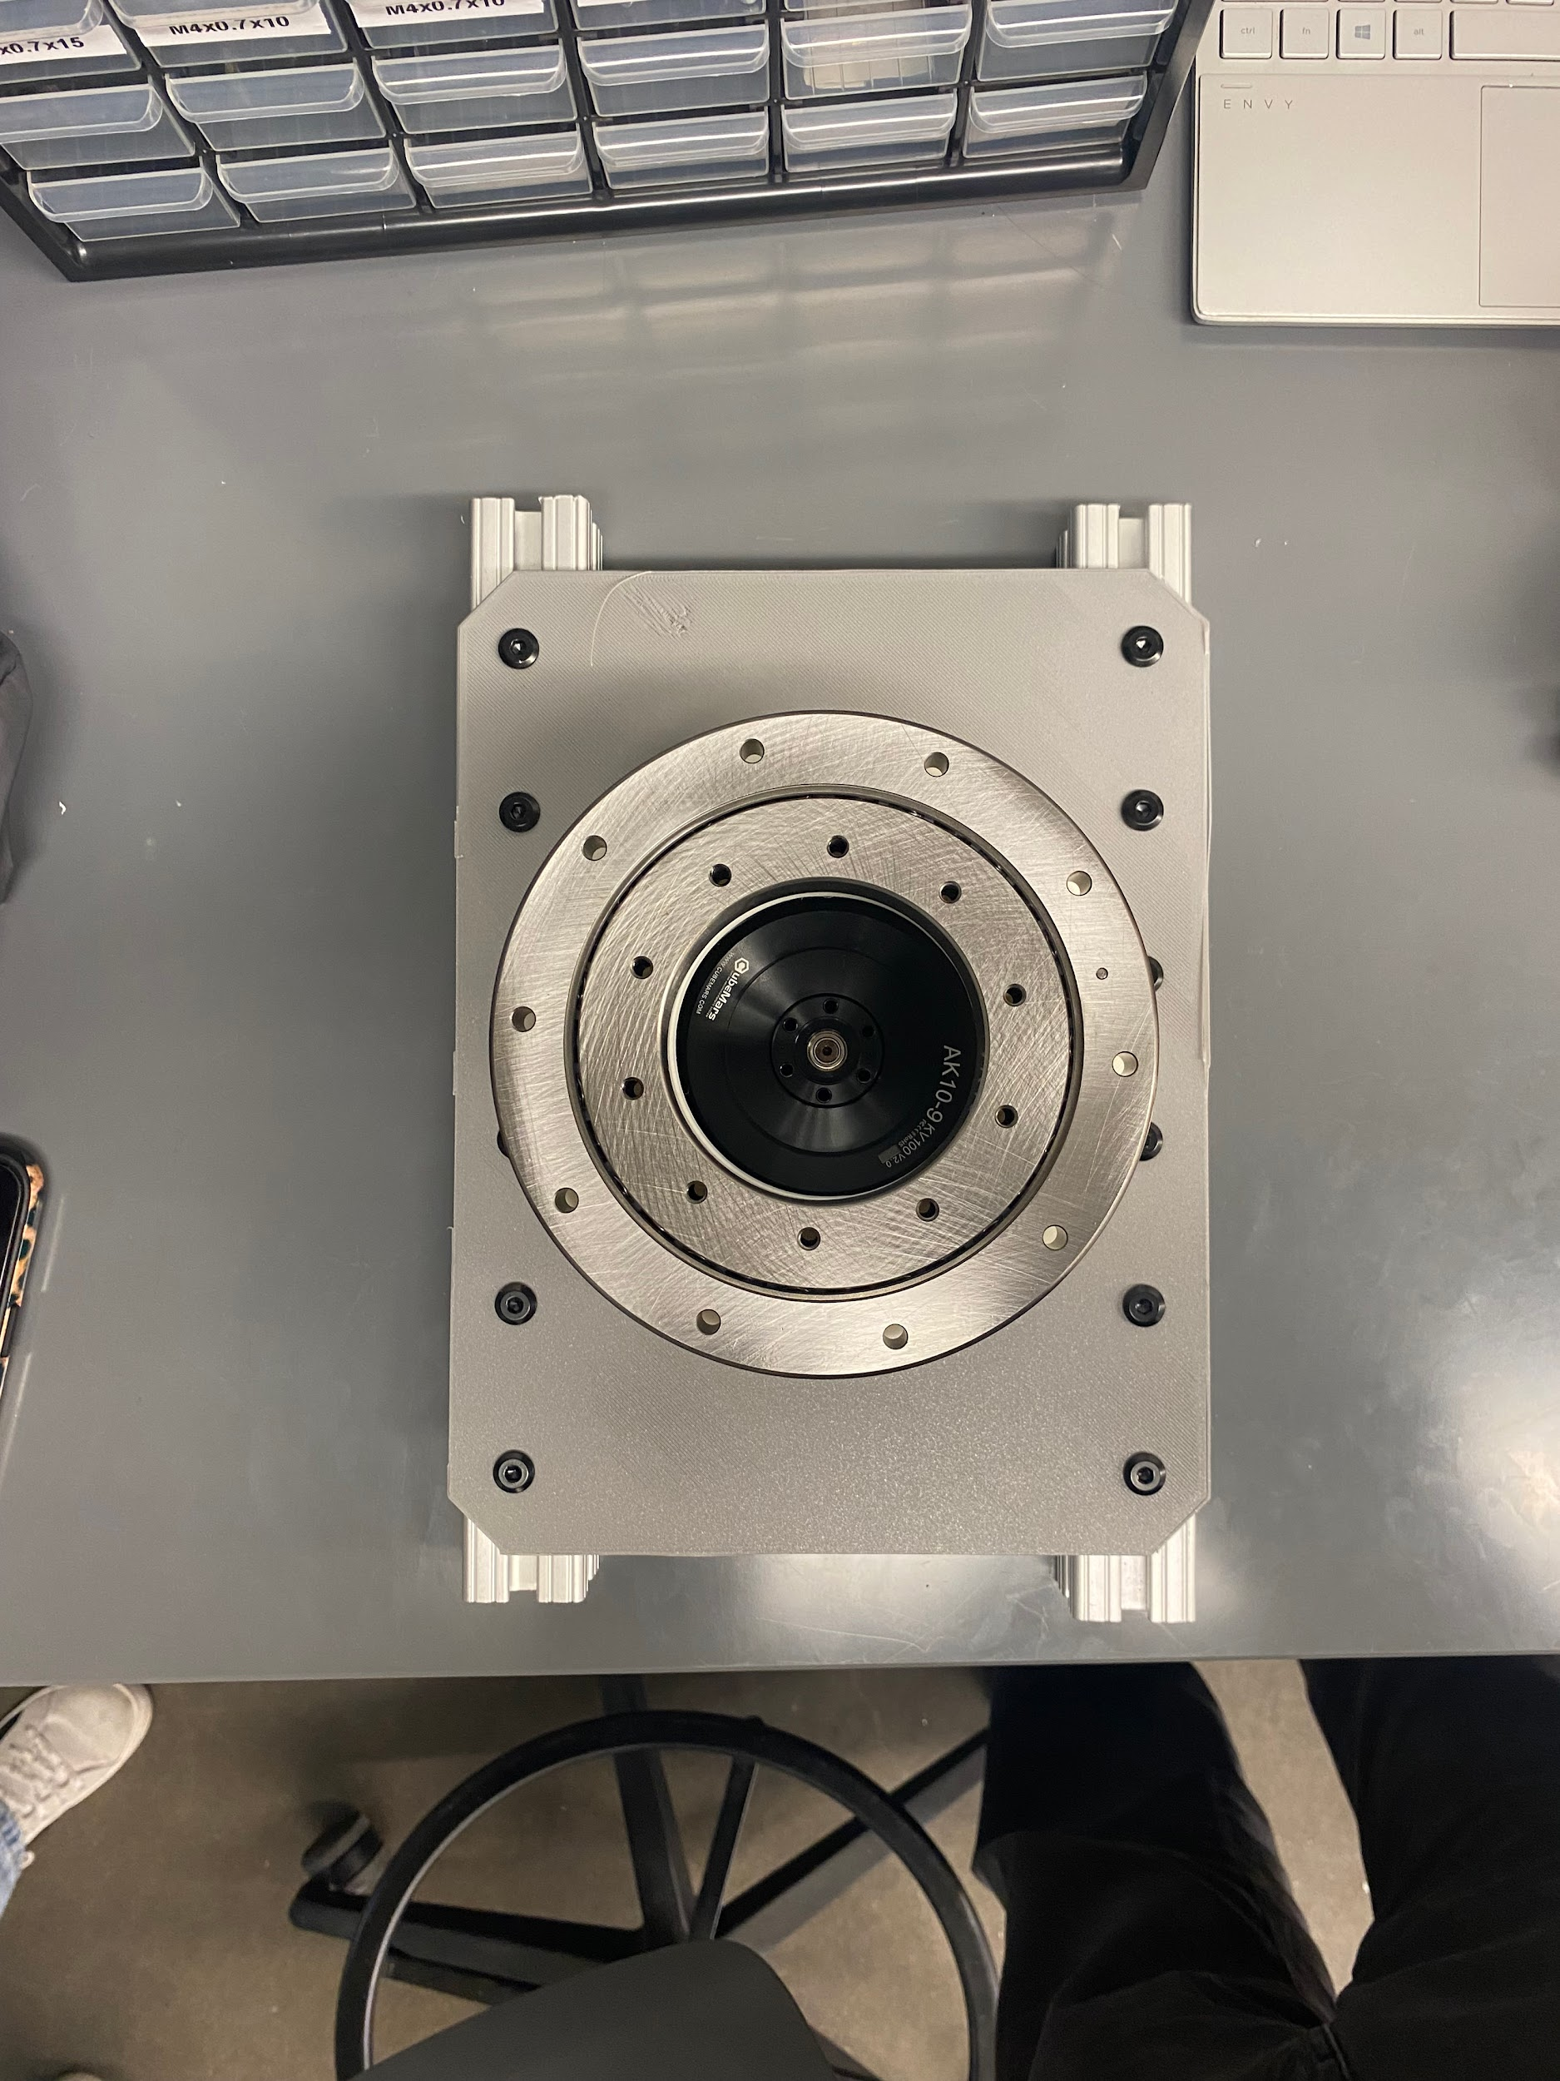
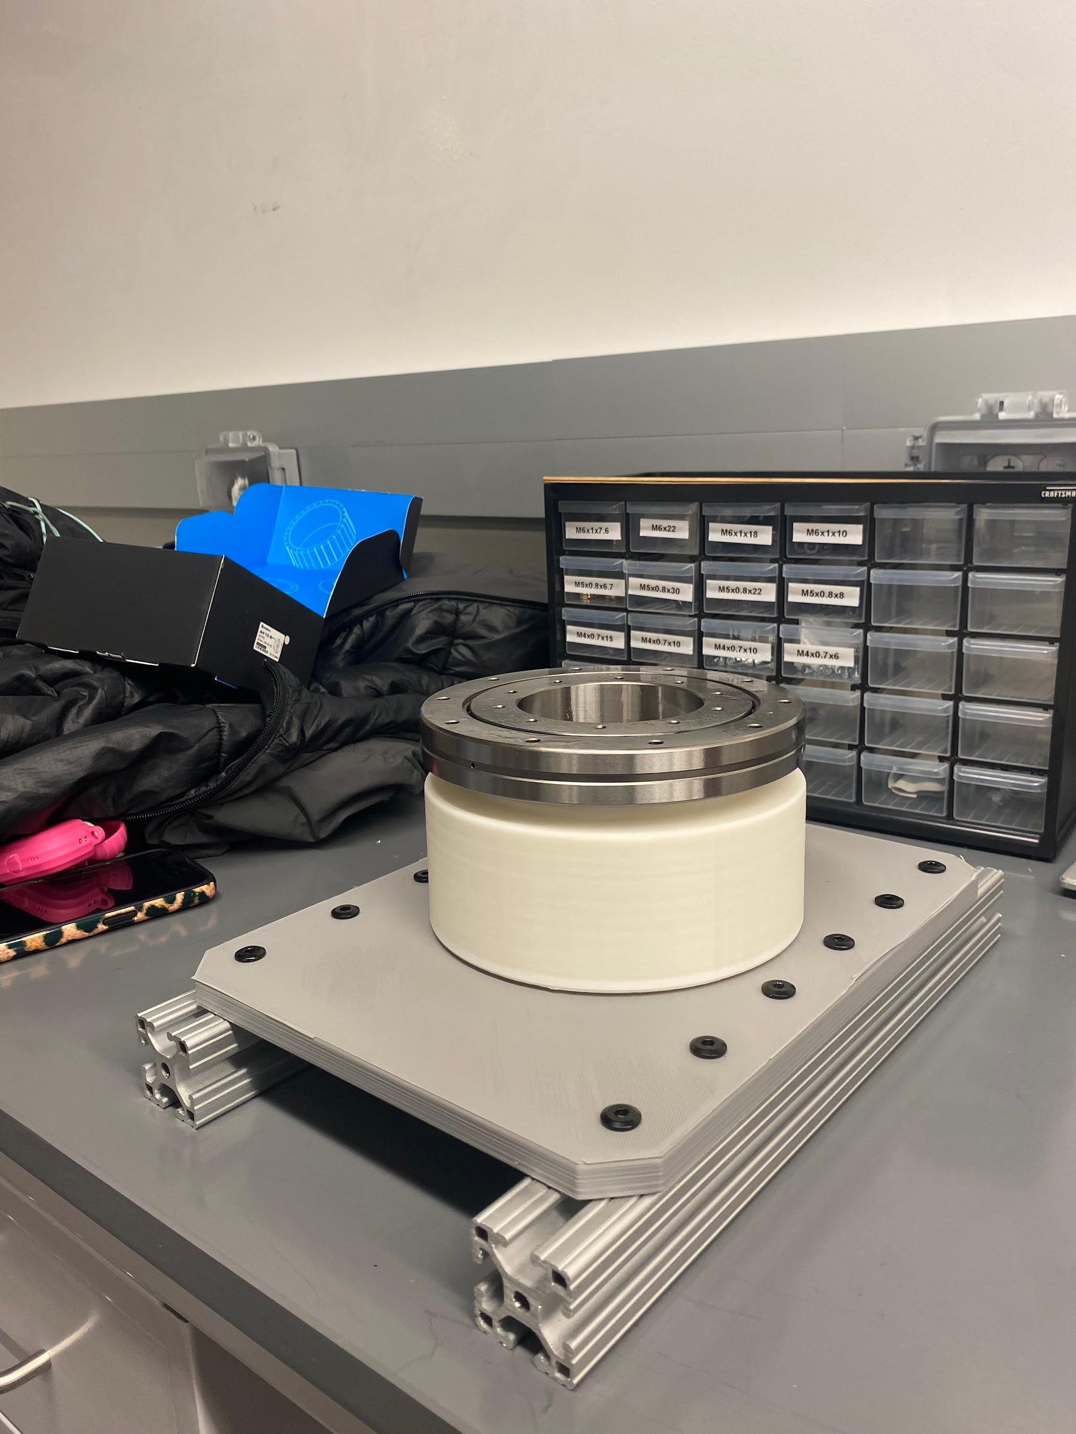
Prototyping/Assembly

Slide 12
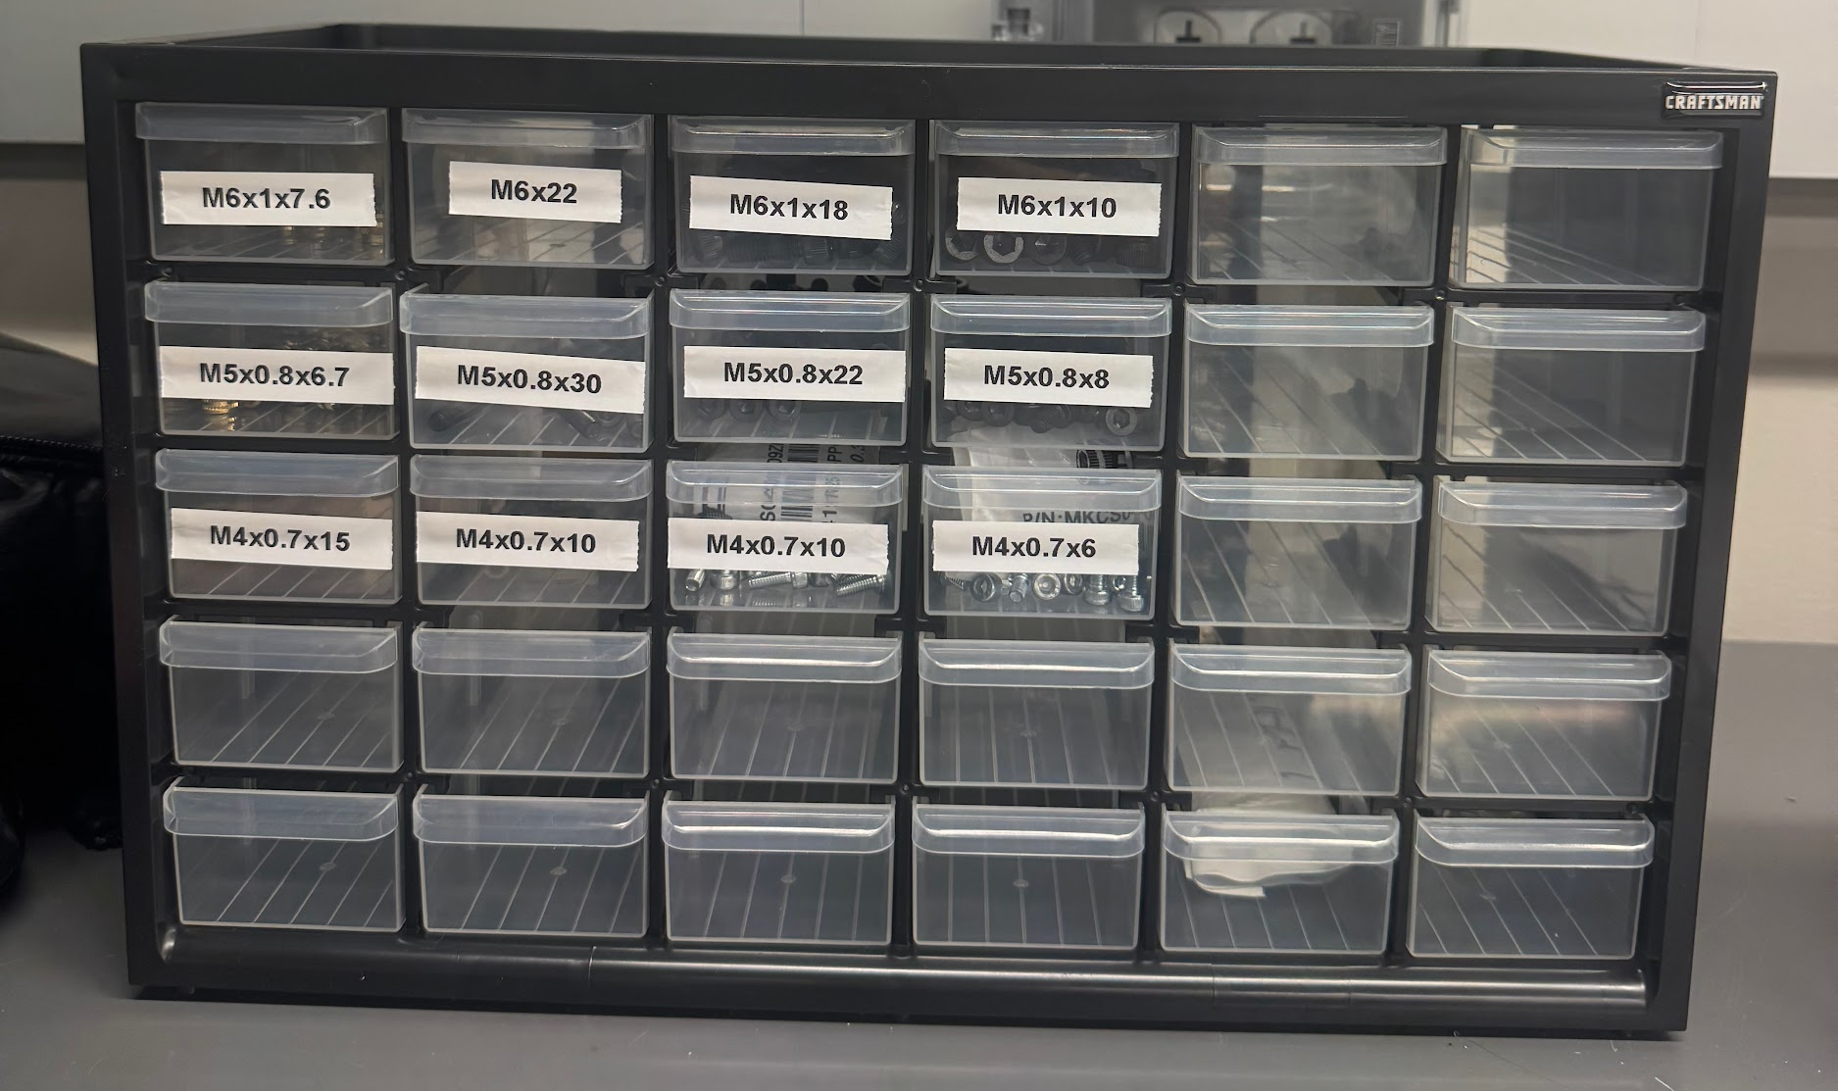
Fasteners
Verification of Fasteners for Base, J1, and J2 are underway
All Fasteners for the Robot are allocated for, plan to order sometime next week after we finish assembling J1 and J2
Morgan organized these fasteners with our organization kit

Slide 13
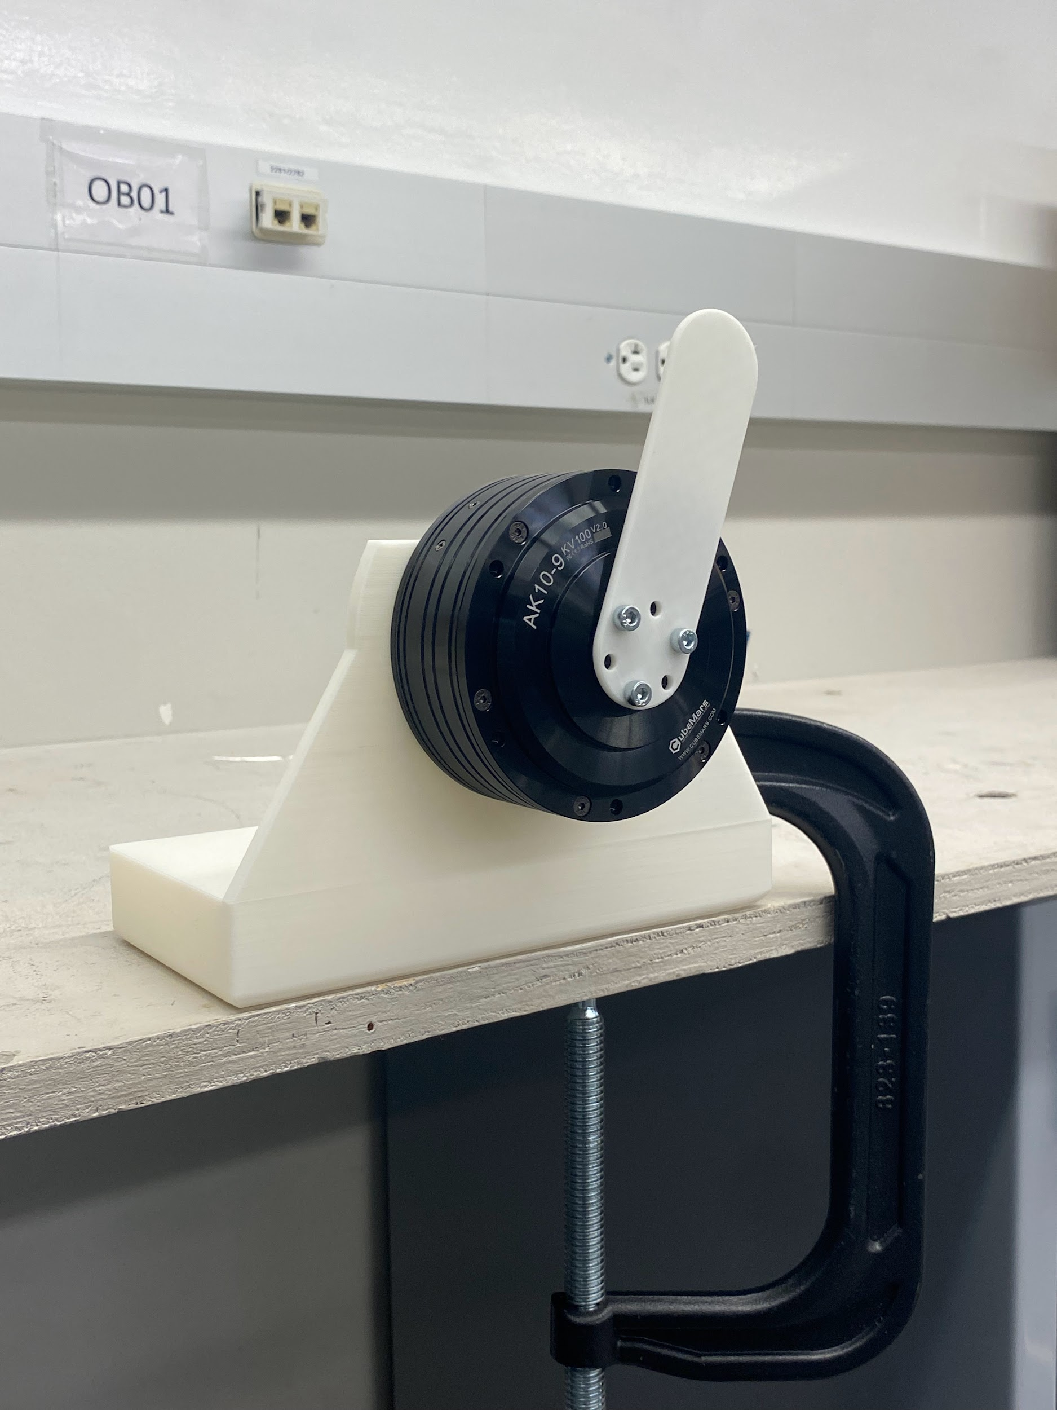
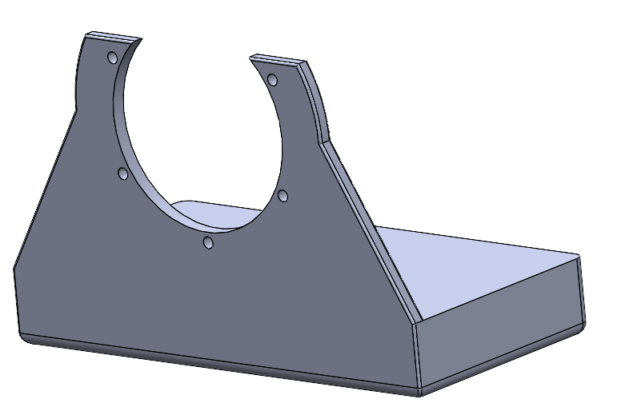
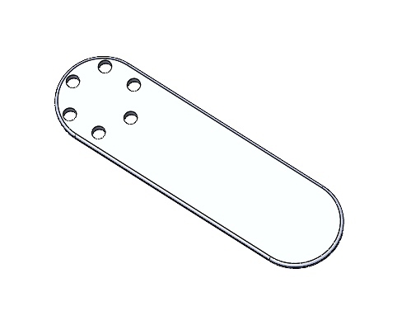
Motor Holder Prototype
Motor Testing: Collaborated with team to identify prototype needs for individual motor testing.
Motor Prototype: Designed and fabricated a motor holder and arm to verify motor rotation.

Slide 14
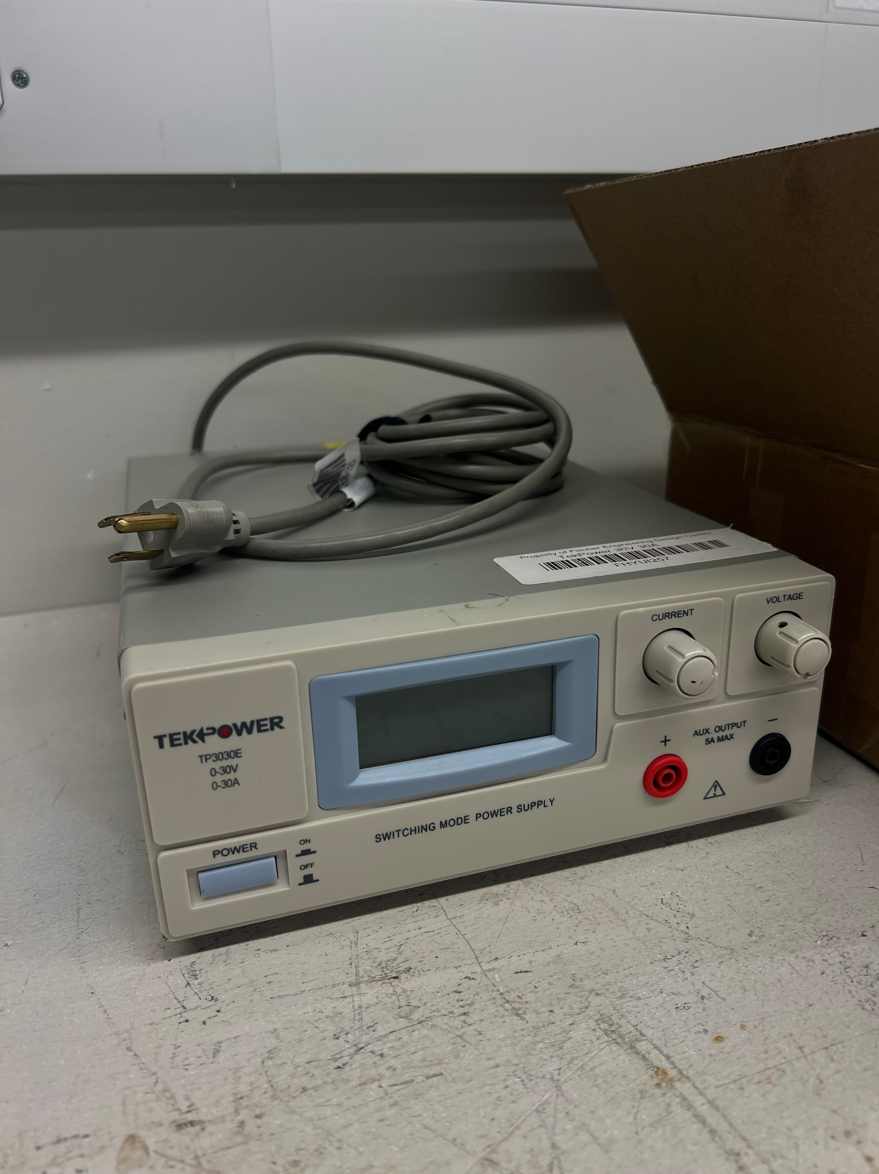
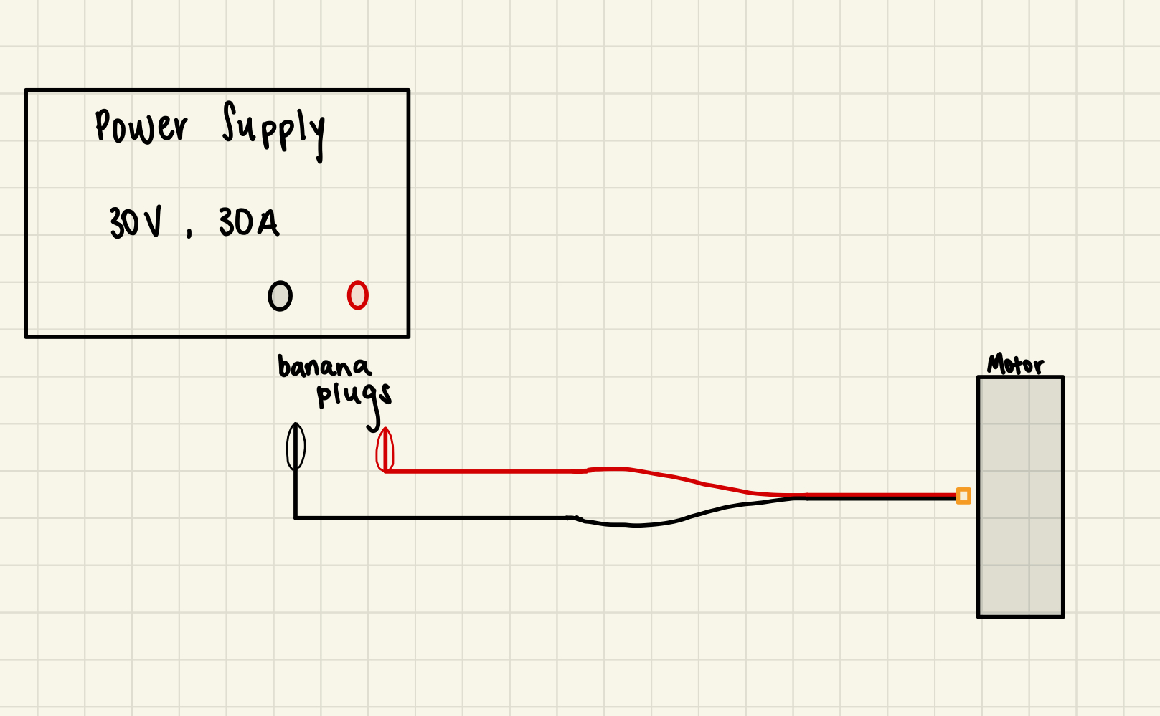
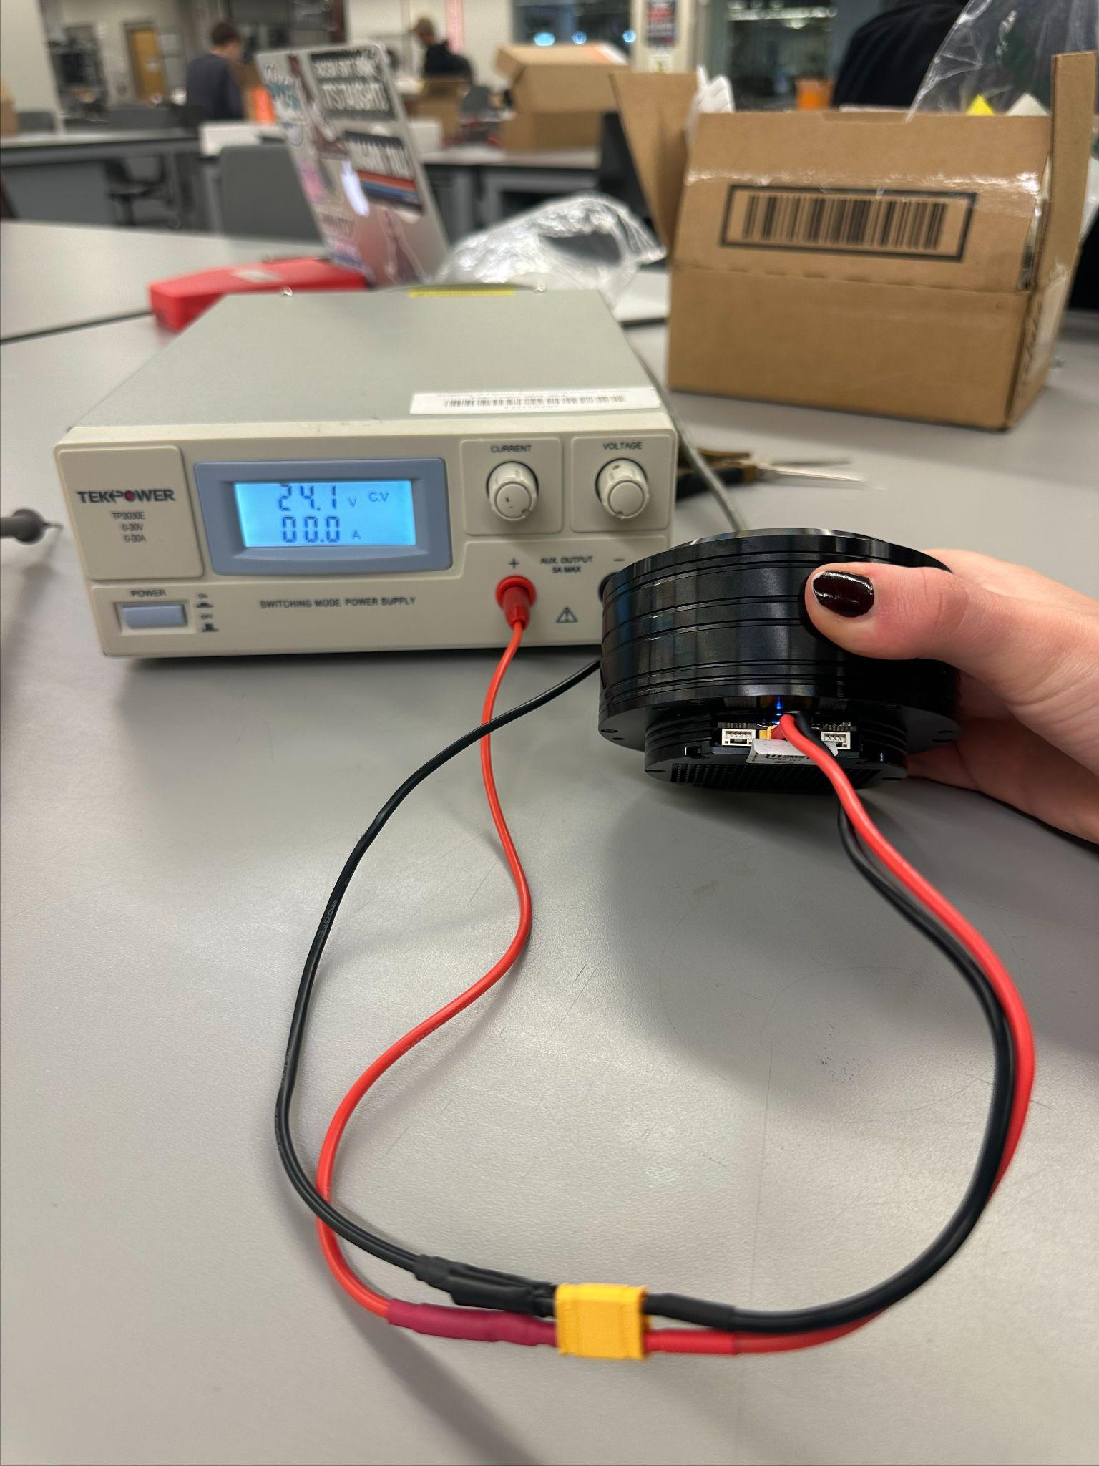
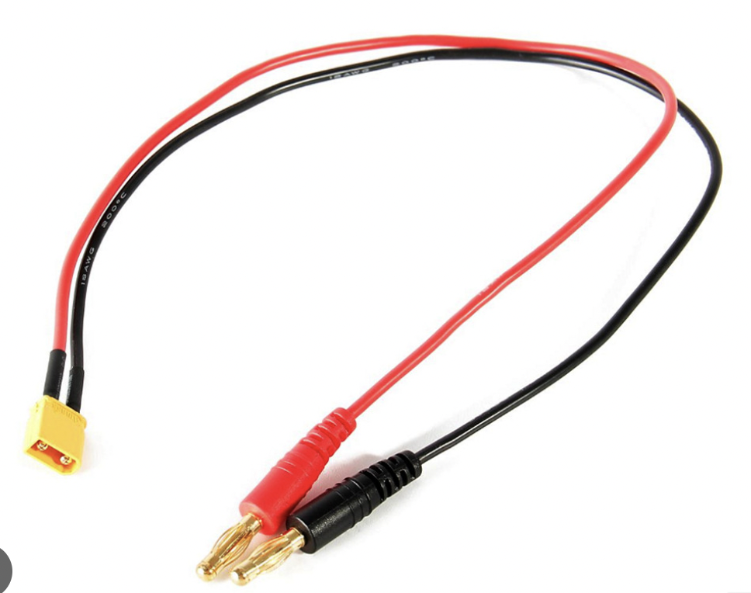
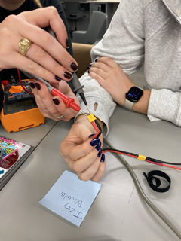
Motor Research/Testing
Preliminary Electrical Testing Setup

Slide 15
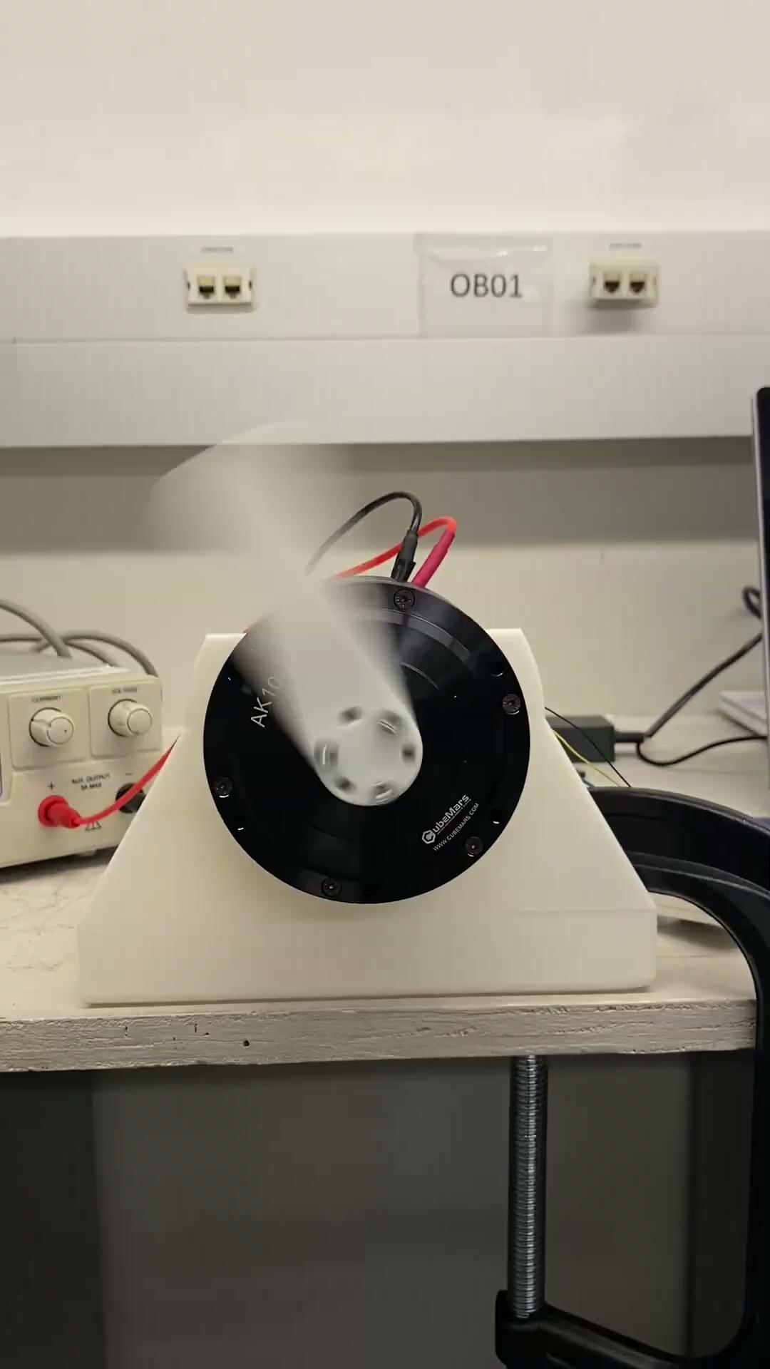
Motor Research
Challenge: Initial attempts to establish communication between the Arduino and CAN, for motor testing, were unsuccessful due to limited Arduino coding expertise and potential setup issues.
Solution: An R-Link was sourced and used to successfully test the Base Motor.
Results: The Base Motor functioned correctly, demonstrating proper position, velocity, and torque control in MIT mode, utilizing the Cube Mars upper computer.
Desire Torque 4.0 Nm
Kp = 0.5

Slide 16
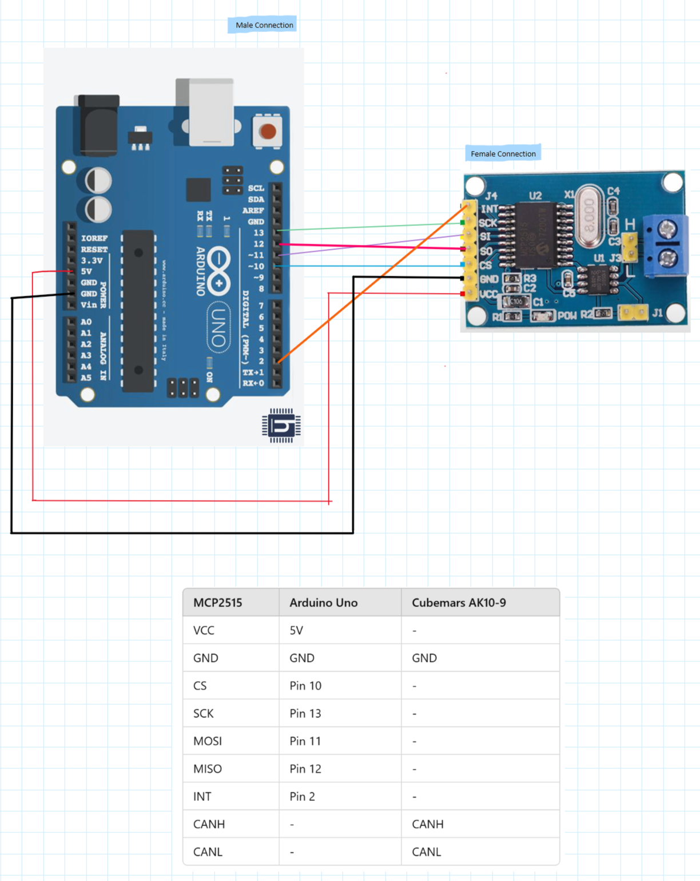
Next Steps for Motor Research
Consultation: We plan to consult with our controls professor to address the Arduino-CAN bus connection issues.
Code Development: We will seek guidance on implementing initial motor control code. (Language: C++)
Multi-Motor Control: We will also discuss strategies for controlling multiple motors simultaneously.

Slide 17
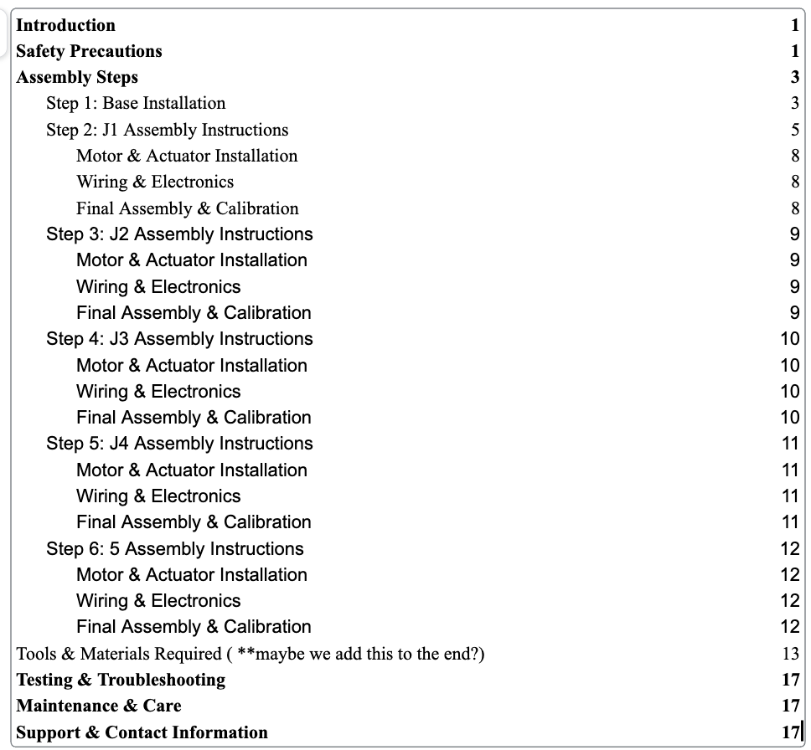
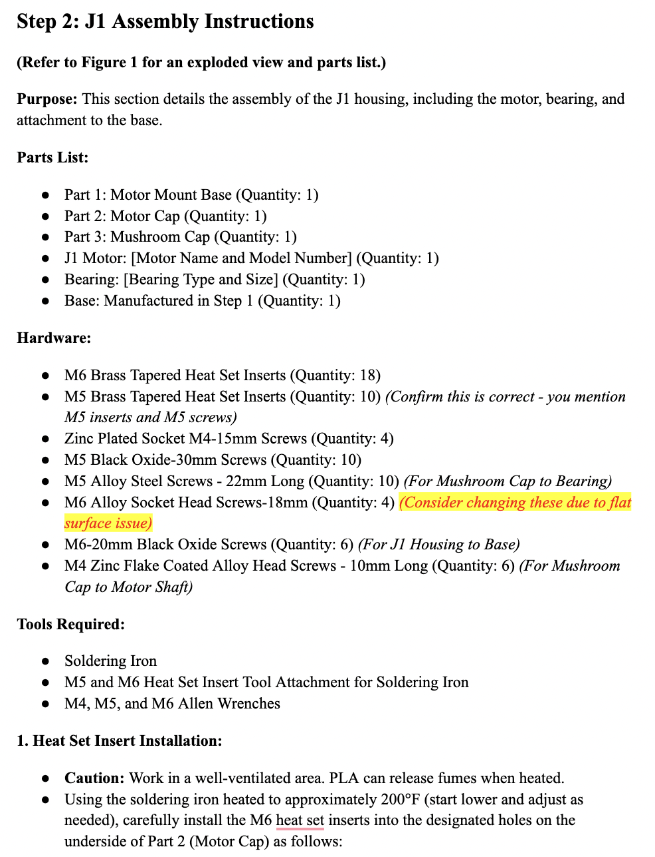
Assembly Manual

Slide 18
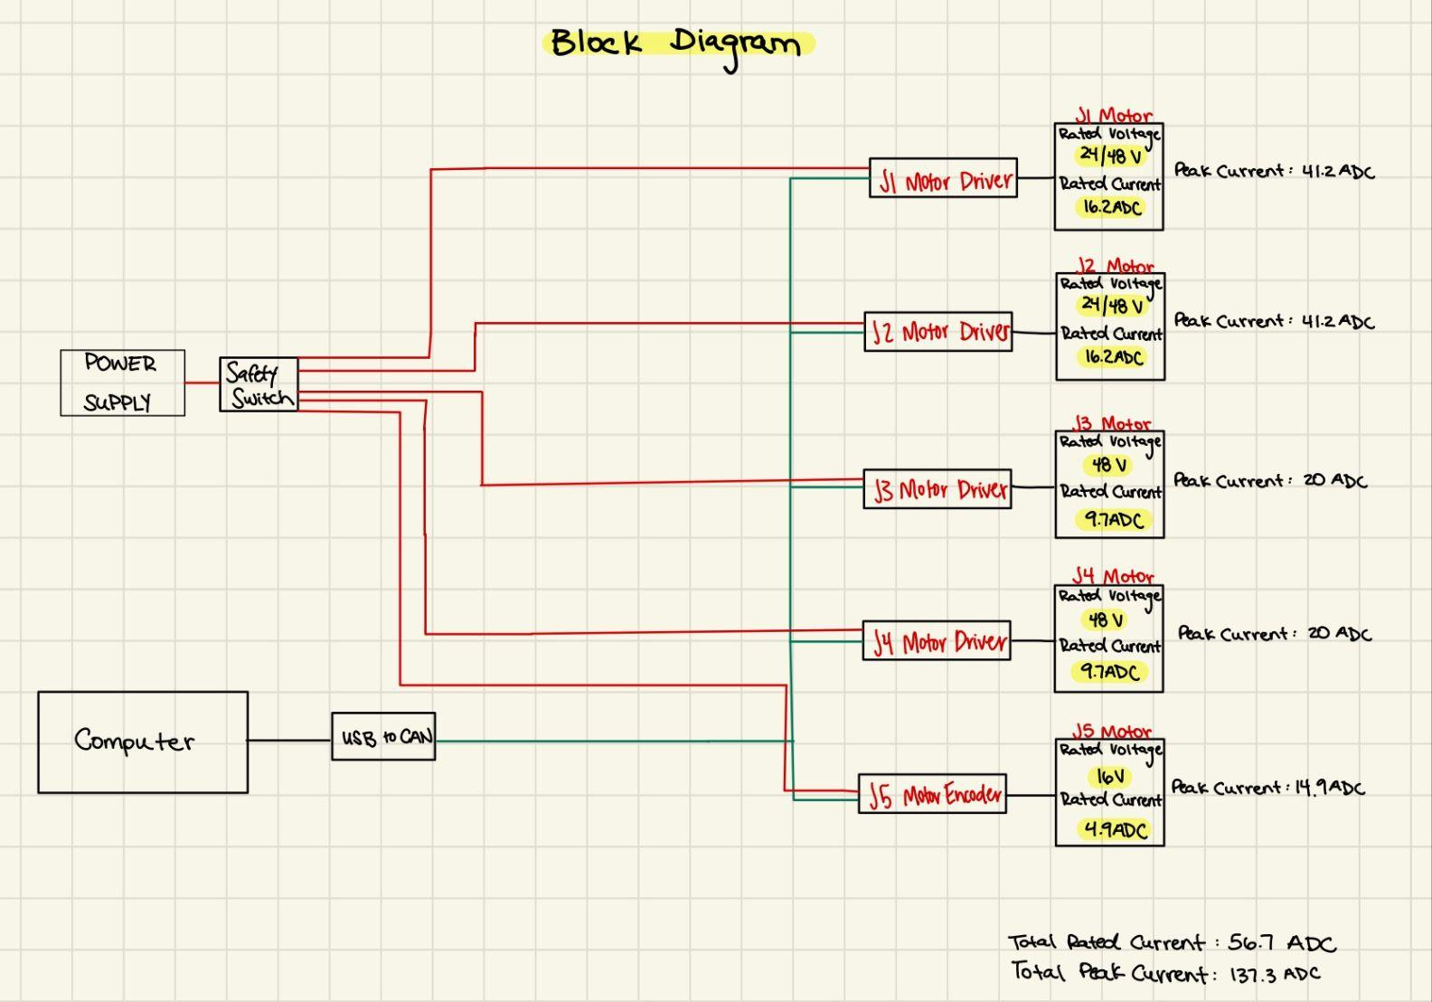
Electrical Block Diagram

Slide 19
Future Work
Order/Verify remaining electrical components
Continue assembling Base, J1, and J2
Print J3, J4, and J5
Continue Assembly Manual
Continue working on midterm report/presentation
Schedule date for Final Presentation (Week of April 21st)
Capstone Showcase April 25th

